Slide 1

Boost Your Development Experience with UI5 Tooling Extensions
A Comprehensive Overview of the UI5 Tooling Ecosystem
Peter Muessig, SAP SE
June 5th, 2024
Notes:
The UI5 tooling is the development and build tooling of UI5. It is built in a modular and extensible way so that it can be easily extended by your needs. This session will showcase various tooling extensions which can boost your development experience by far so that you can really work offline, transpile your code in your project to use even newer versions of EcmaScript (than 2022 which is supported right now by the UI5 tooling), consume any npm package of your choice in your project, using different kind of proxies, and even stitching UI5 projects during development together to mimic your target environment.

Slide 2
“There’s nothing more important than an efficient development environment!”

Slide 3

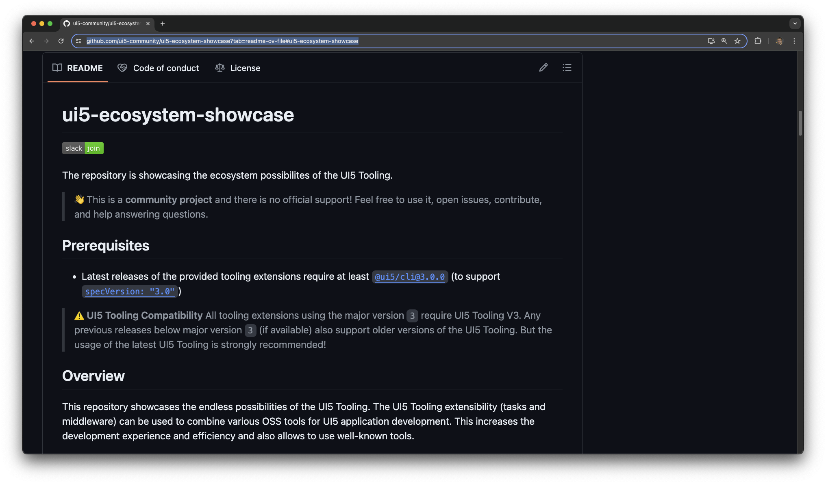


UI5 Ecosystem Showcase
UI5 Tooling Extensions and more…
Started to show-case the simplicity to extend the UI5 Tooling (2018)
Became the home of several UI5 Tooling extensions – thanks to all contributors!
Additionally also provides other tools, such as a CDS Plugin to work seamless with UI5… (2023)

Slide 4
UI5 Ecosystem Showcase
What’s in for you? Let’s take a closer look!
ui5-middleware-webjars
ui5-middleware-ui5
ui5-middleware-simpleproxy
ui5-task-cachebuster
ui5-task-copyright
ui5-task-flatten-library
ui5-middleware-approuter
ui5-middleware-livereload
Custom Tasks
ui5-middleware-index
Custom Middlewares
ui5-middleware-cap
ui5-task-i18ncheck
ui5-task-pwa-enabler
ui5-middleware-onelogin
ui5-middleware-servestatic
ui5-task-minify-xml
ui5-task-zipper
ui5-middleware-serveframework
ui5-middleware-websocket
ui5-middleware-iasync
ui5-tooling-modules
CDS Plugin
ui5-tooling-stringreplace
Karma Preprocessor
Express.js Utilities
Tooling Extensions
And there`s even more
https://bestofui5.org/
ui5-tooling-less
Other Stuff
ui5-tooling-transpile
Approuter (dev)
Showcases
Apps
Libs
Modules
JavaScript
TypScript

Slide 5
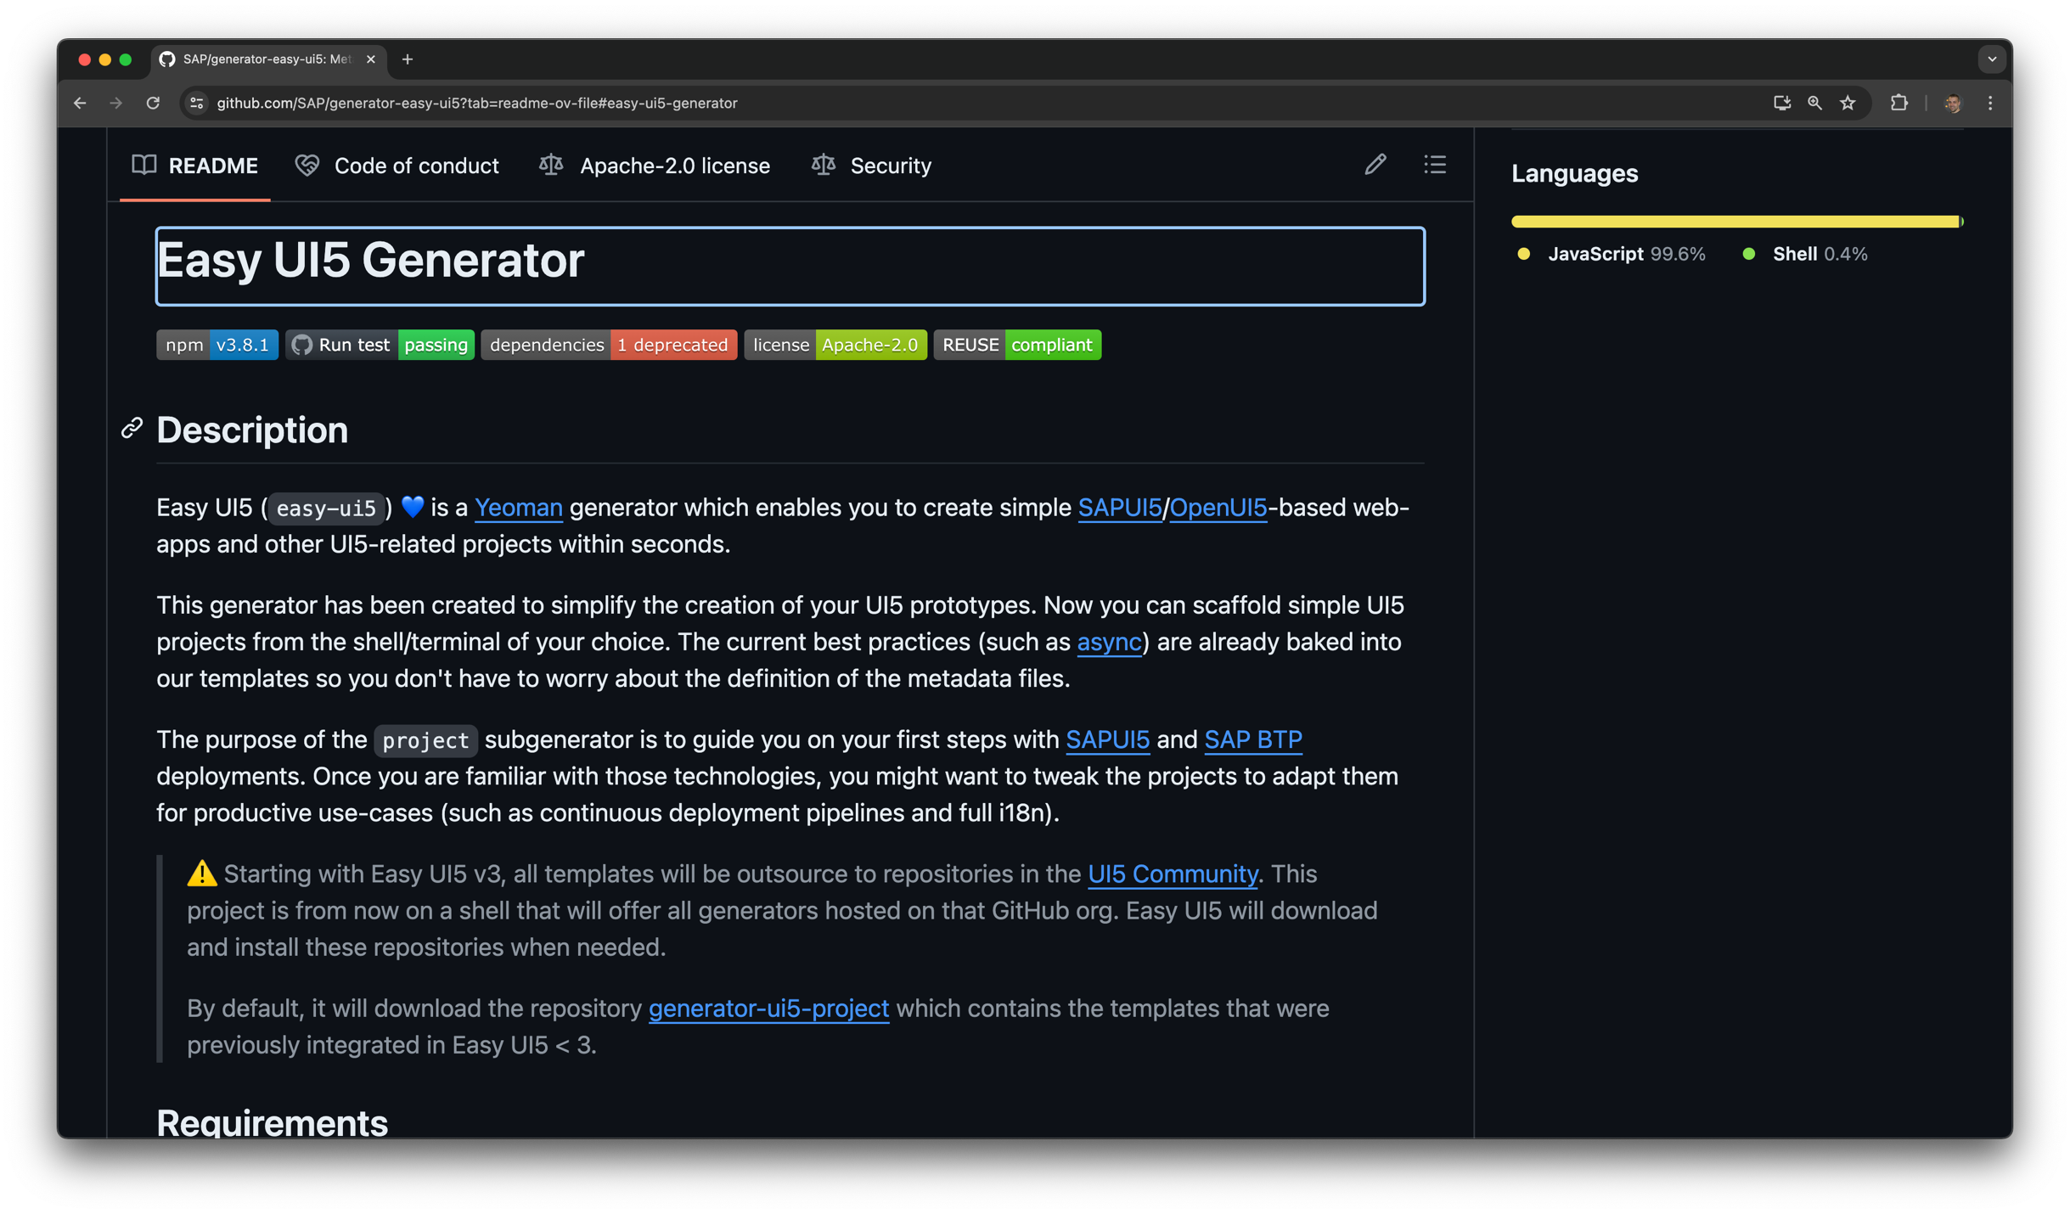
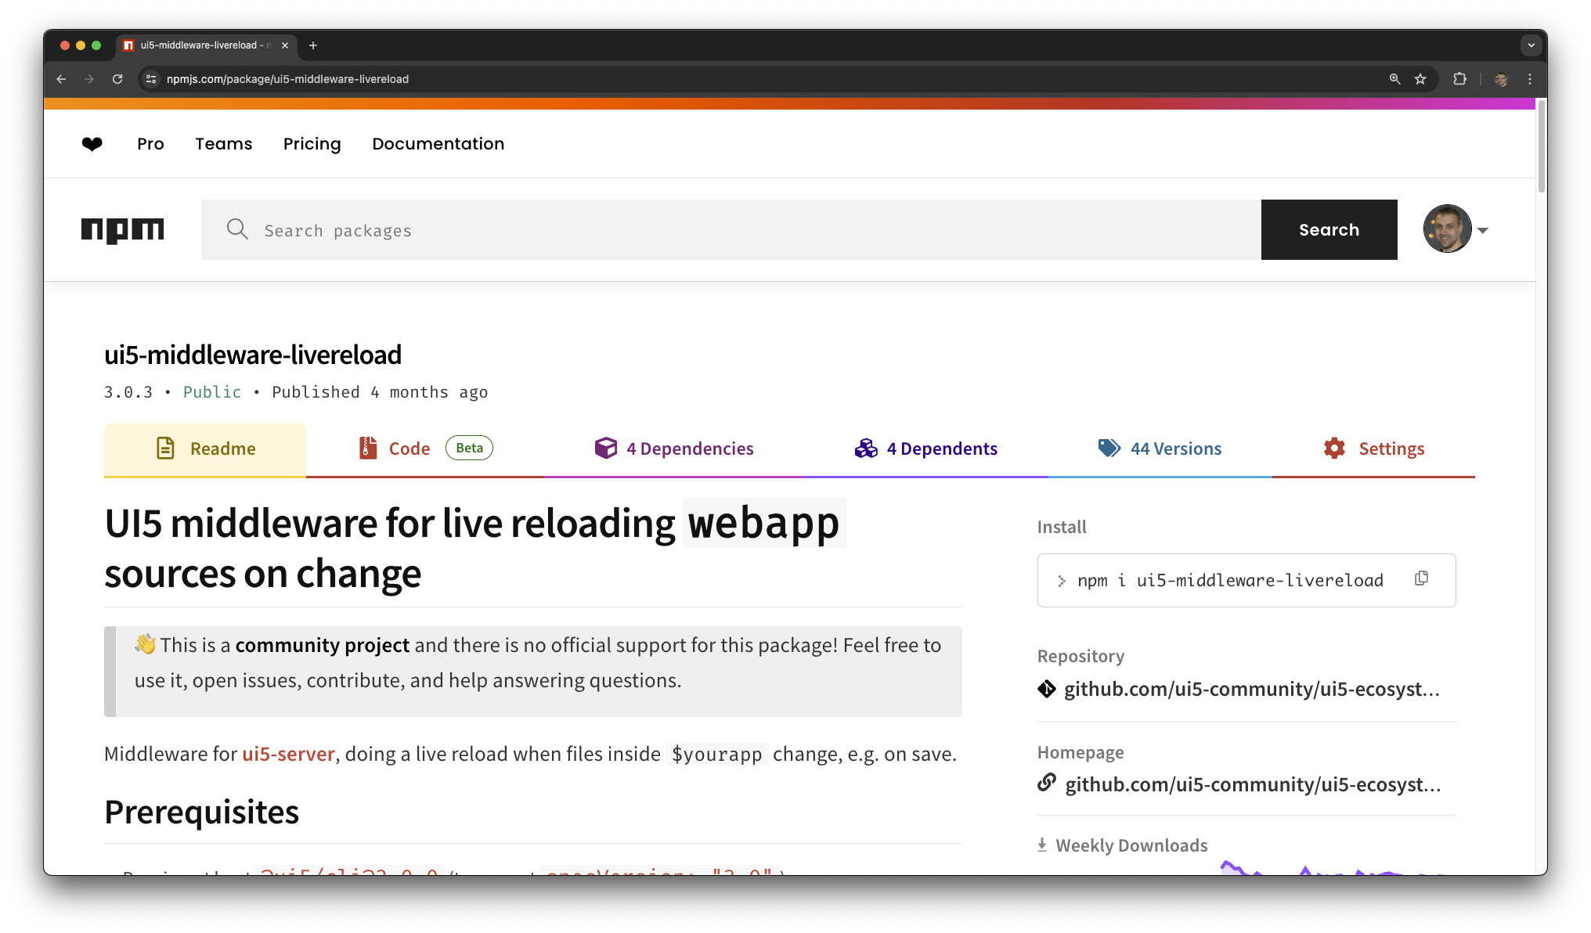
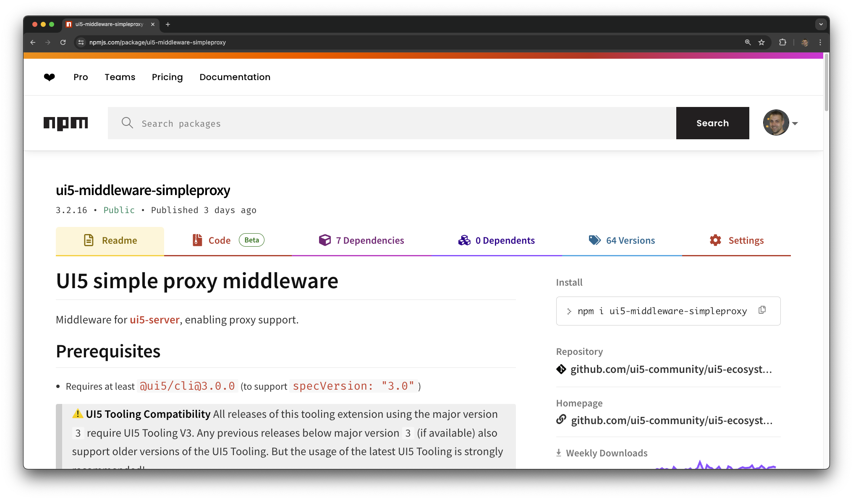
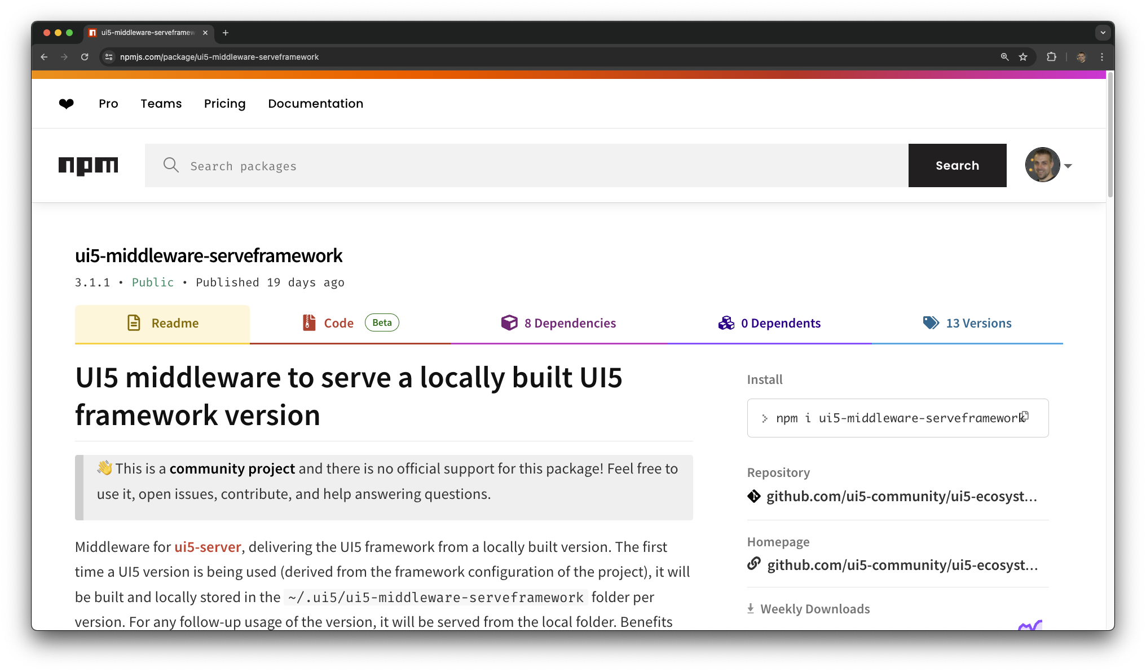
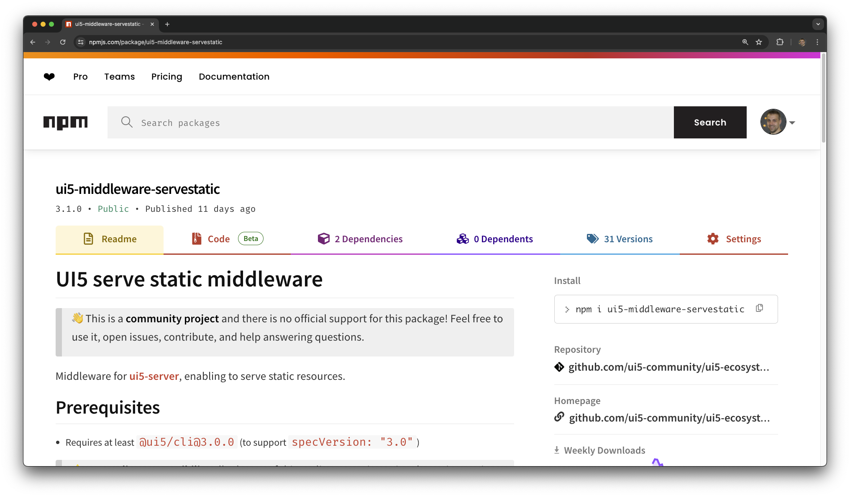
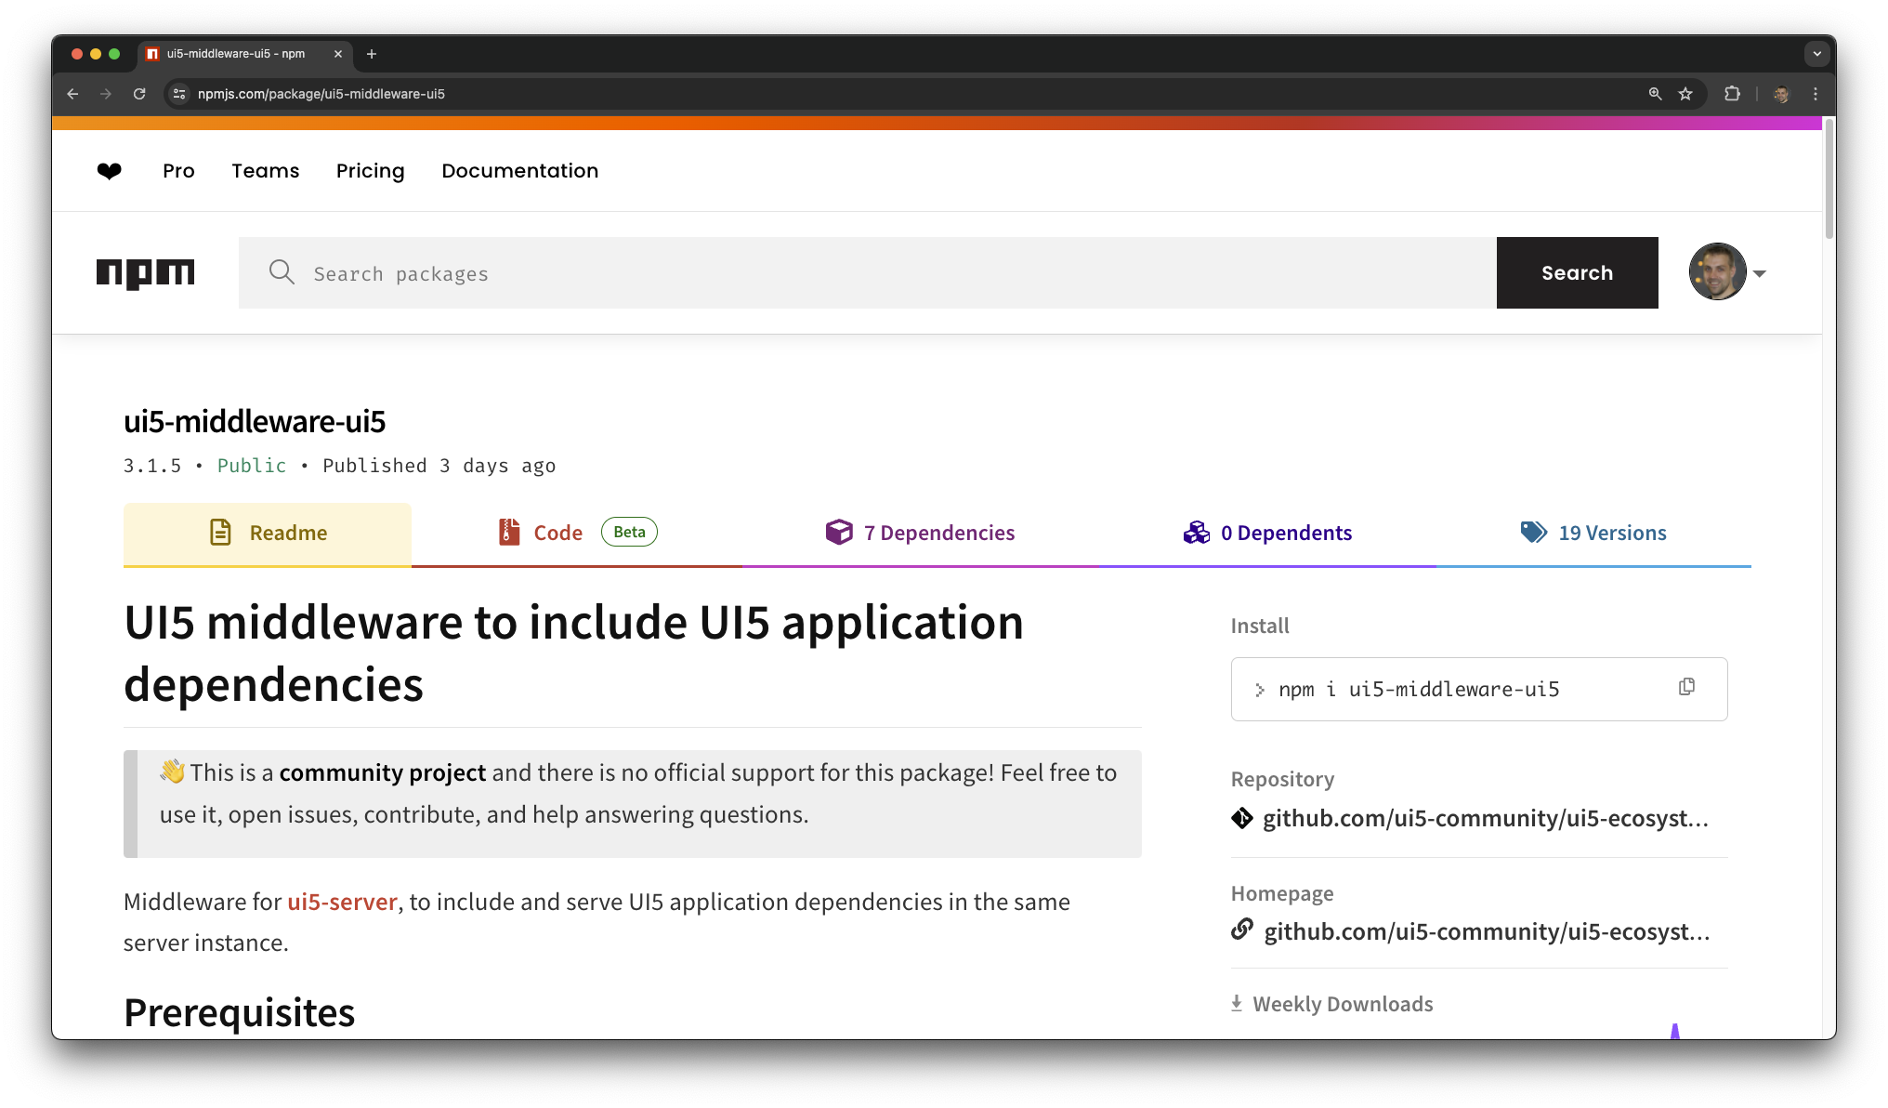
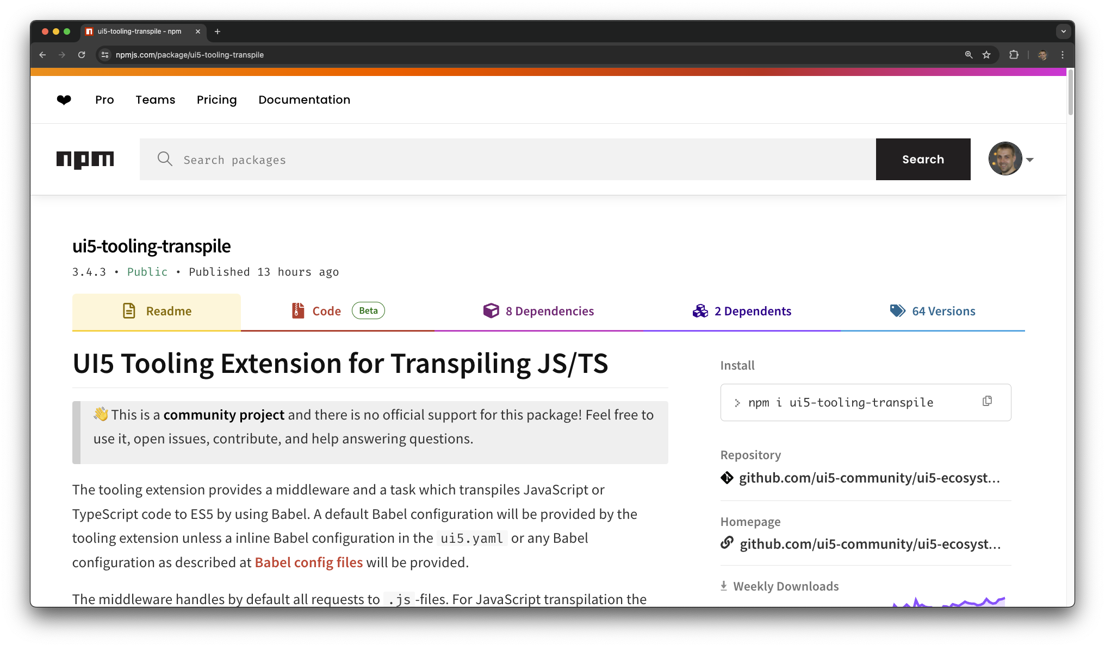
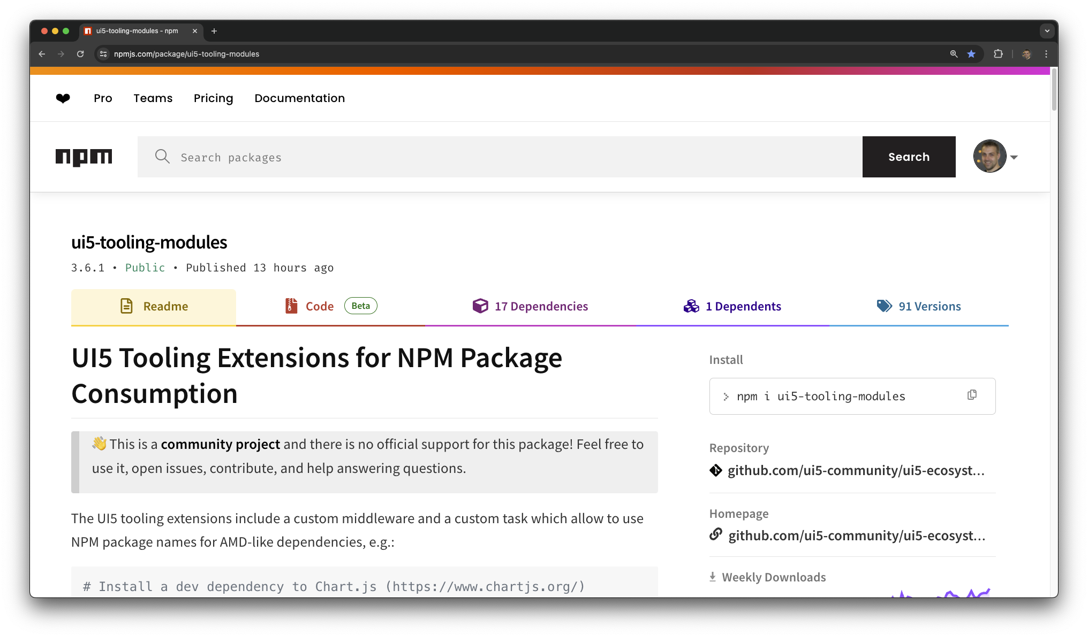
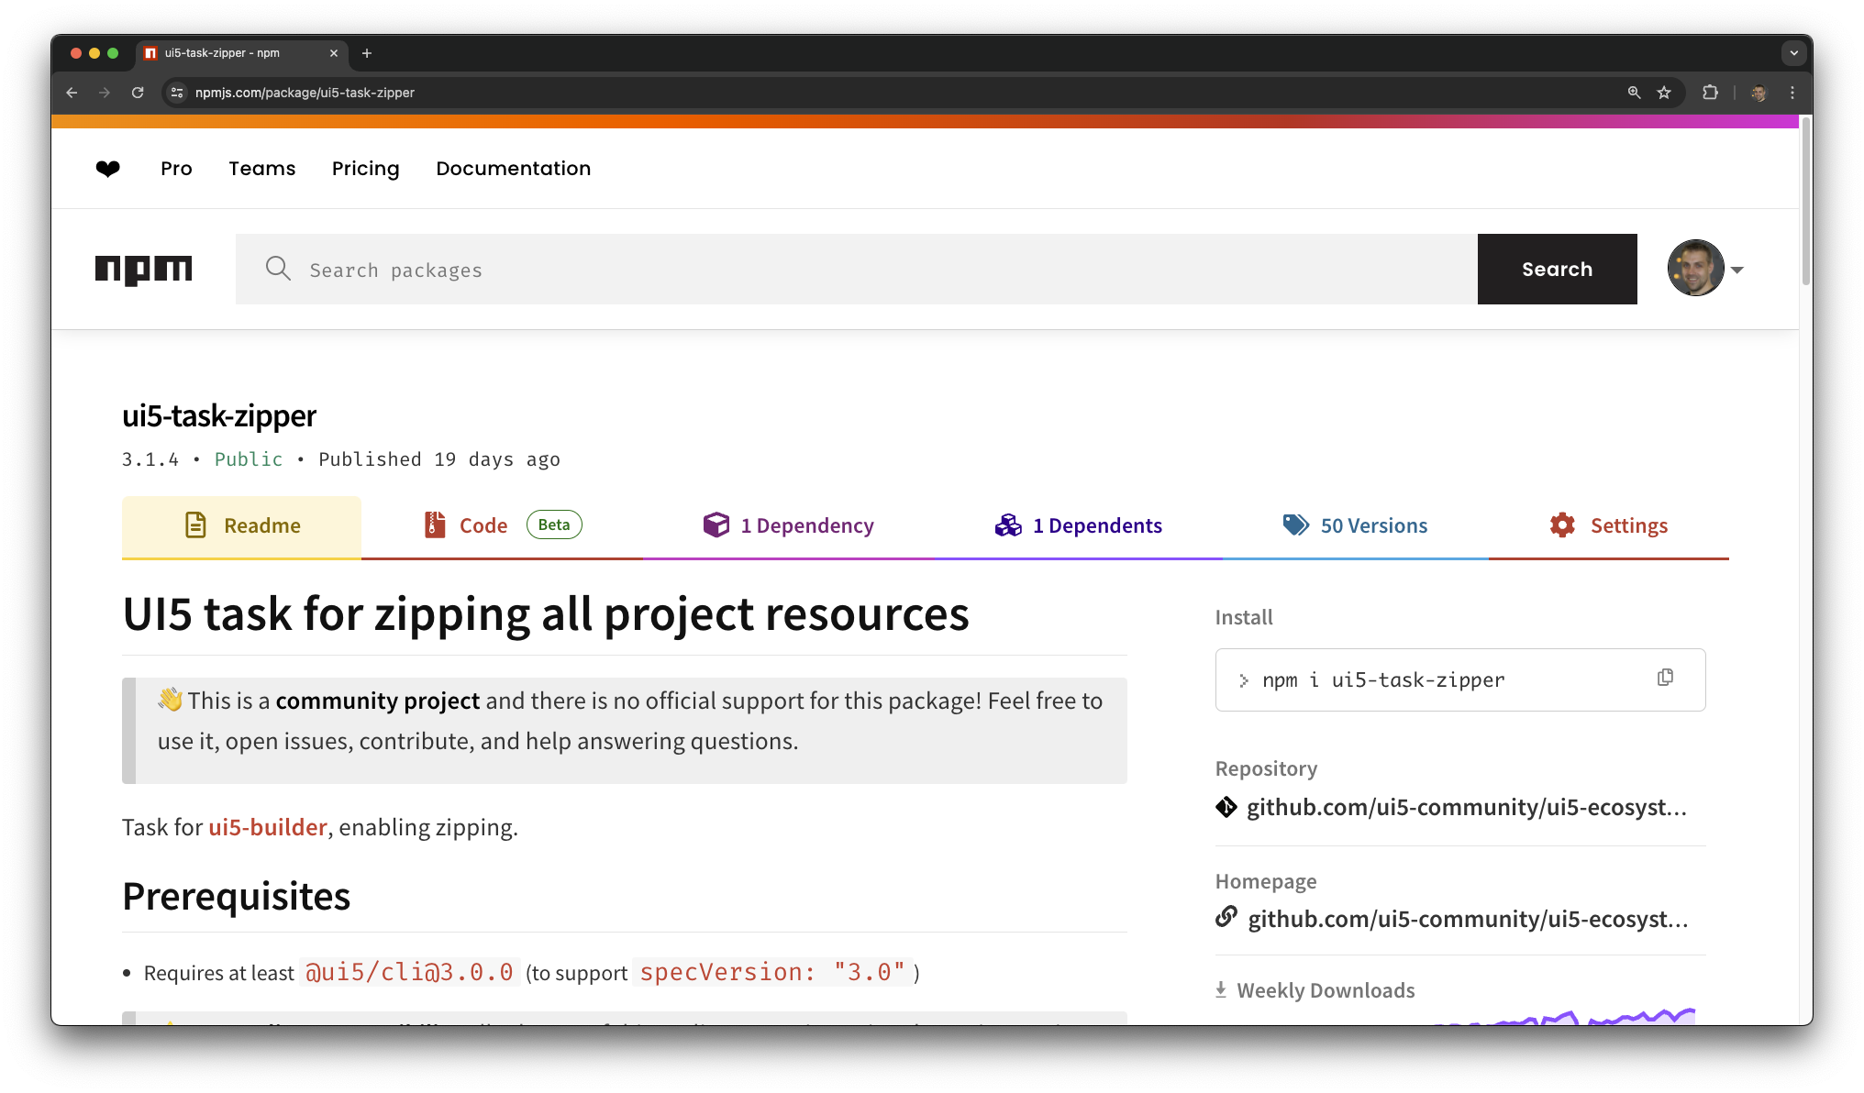
Insights to Selected UI5 Tooling Extensions
My Favourites
> yo easy-ui5
ui5-middleware-livereload
ui5-middleware-simpleproxy
ui5-middleware-serveframework
ui5-middleware-servestatic
ui5-middleware-ui5
ui5-tooling-transpile
ui5-tooling-modules
ui5-task-zipper

Slide 6
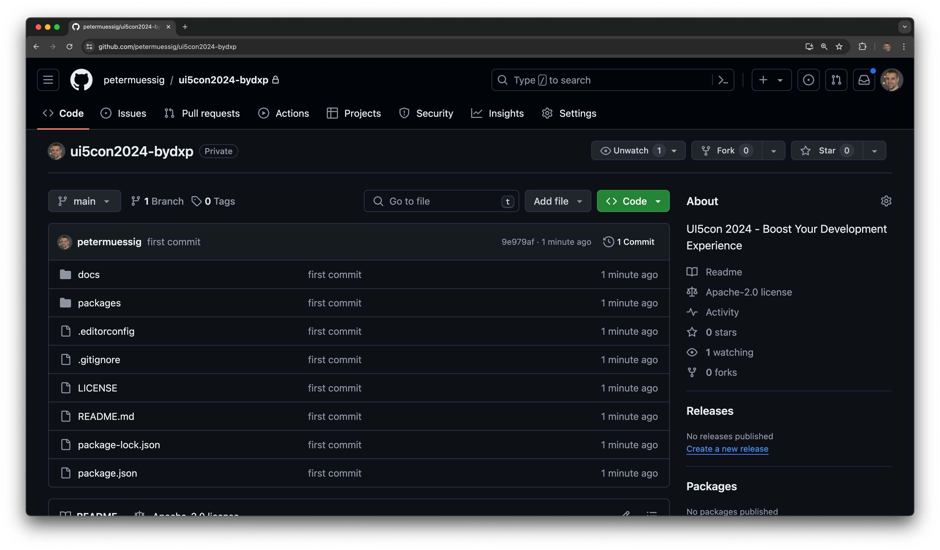

GitHub: Boost Your Dev Experience
Checkout the Showcase
Contains:
Application
UI Library
Reuse Component
Showcases:
Reuse of Custom Control from UI Library
Embedding of Reuse Components
Writing modern JS code
Usage of npm packages
And much more…

Slide 7

Thank you!
Peter Muessig
Chief Architect, UI5, SAP SE
peter.muessig@sap.com
SAP Community: @peter.muessig
X/Twitter: @pmuessig
Linkedin: pmuessig

